Slide 1
Oracle Pre-SSMA Query Guidance
Lou Carbone
Data Insights Global Lead Solution Architect
October 2016
Data Migration Jumpstart Engineering Team

Slide 2
What is it?
PL/SQL query that hits oracle system tables
Non-evasive query
Count of objects by schema, object type and status
Gives a rough estimate of ‘Raw data’ in each schema
Provides a sizing of tables in each schema
Results are stored in a CSV
Data Migration Jumpstart Engineering Team

Slide 3
Benefits
Helps classify schemas
(simple, moderate, complex, custom)
Helps target high-profile schemas for analysis
Helps identify user accounts too
Sizing information
Goes beyond identifying SSMA objects
Data Migration Jumpstart Engineering Team

Slide 4
Object Types
Cluster
Consumer Group
Context
Destination
Directory
Edition
Evaluation Context
Index Partition
Index Subpartition
Index Type
Java Class
Java Data
Java Resource
Java Source
Job
Job Class
Library
Operator
Program
Rule
Rule Set
Schedule
Scheduler Group
Table Partition
Table Subpartition
Window
XML Schema
Function
Index
Materialized View
Package
Package body
Procedure
Sequence
Synonym
Table
Trigger
Type
Type Body
View
Raw Data (Mb)
Table Sizing
Data Migration Jumpstart Engineering Team

Slide 5
The query
REM FUNCTION: List the count of objects for each object type under each non-system schema
REM REQUIRES: v$instance, sys.all_objects
SET newpage 0;
SET pagesize 50000 ;
SET echo OFF ;
SET feedback OFF ;
SET verify OFF ;
SET markup html OFF;
SET linesize 250 ;
--
--
-- this is the output file that will capture the data use this first, then comment and uncommend second line for subsequent use
SPOOL D:\Data\PreSSMAOutput.csv REPLACE
--SPOOL D:\Data\PreSSMAOutput.csv APPEND
set termout off
SET HEADING OFF
SELECT host_name || ',' ||
instance_name || ',' ||
version || ',' ||
owner || ',' ||
object_type || ',' ||
B.status || ',' ||
COUNT(object_id) "Svr,Inst,Ver,Sch,ObTyp,Stat,Ct"
FROM v$instance a, sys.all_objects b
WHERE owner NOT IN ('OWBSYS_AUDIT', 'MDSYS', 'PUBLIC', 'OUTLN', 'CTXSYS', 'OLAPSYS',
'FLOWS_FILES', 'OWBSYS', 'SYSTEM', 'HR', 'ORACLE_OCM', 'EXFSYS',
'SCOTT', 'SH', 'PM', 'DBSNMP', 'ORDSYS', 'ORDPLUGINS', 'SYSMAN', 'OE', 'IX',
'APPQOSSYS', 'XDB', 'ORDDATA', 'BI', 'SYS', 'WMSYS', 'SI_INFORMTN_SCHEMA' )
AND owner NOT LIKE 'APEX_%'
GROUP BY host_name, instance_name, version, owner, object_type, b.status
ORDER BY owner, object_type, b.status ;
Data Migration Jumpstart Engineering Team

Slide 6
more query
SELECT host_name || ',' ||
instance_name || ',' ||
version || ',' ||
C.owner || ',Raw Data (Mb),VALID,' ||
Round( sum(avg_row_len*num_rows)*0.000001,2) "Svr,Inst,Ver,Sch,ObTyp,Stat,Ct"
FROM v$instance a,
dba_tables C
WHERE owner NOT IN ('OWBSYS_AUDIT', 'MDSYS', 'PUBLIC', 'OUTLN', 'CTXSYS', 'OLAPSYS',
'FLOWS_FILES', 'OWBSYS', 'SYSTEM', 'HR', 'ORACLE_OCM', 'EXFSYS',
'SCOTT', 'SH', 'PM', 'DBSNMP', 'ORDSYS', 'ORDPLUGINS', 'SYSMAN', 'OE', 'IX',
'APPQOSSYS', 'XDB', 'ORDDATA', 'BI', 'SYS', 'WMSYS', 'SI_INFORMTN_SCHEMA' )
AND owner NOT LIKE 'APEX_%'
GROUP BY host_name, instance_name, version, c.owner
ORDER BY owner
;
Data Migration Jumpstart Engineering Team

Slide 7
more query
SELECT host_name || ',' ||
instance_name || ',' ||
version || ',' ||
C.owner || '.' ||
c.table_name || ',Table Sizing,' ||
avg_row_len || ',' ||
avg_row_len*num_rows "Svr,Inst,Ver,Sch,ObTyp,Stat,Ct"
FROM v$instance a,
dba_tables C
WHERE owner NOT IN ('OWBSYS_AUDIT', 'MDSYS', 'PUBLIC', 'OUTLN', 'CTXSYS', 'OLAPSYS',
'FLOWS_FILES', 'OWBSYS', 'SYSTEM', 'HR', 'ORACLE_OCM', 'EXFSYS',
'SCOTT', 'SH', 'PM', 'DBSNMP', 'ORDSYS', 'ORDPLUGINS', 'SYSMAN', 'OE', 'IX',
'APPQOSSYS', 'XDB', 'ORDDATA', 'BI', 'SYS', 'WMSYS', 'SI_INFORMTN_SCHEMA' )
AND owner NOT LIKE 'APEX_%' and Avg_Row_Len > 0
ORDER BY owner
;
Data Migration Jumpstart Engineering Team

Slide 8
Running the query
Run 1x in each instance
Helps to eliminate schemas you are not interested in
If capturing data in same directory or file:
SPOOL D:\Data\PreSSMAOutput.csv REPLACE
--SPOOL D:\Data\PreSSMAOutput.csv APPEND
Data Migration Jumpstart Engineering Team

Slide 9
The output
LCARBONE-W530,orcl,12.1.0.2.0,AUDSYS,INDEX,VALID,3
LCARBONE-W530,orcl,12.1.0.2.0,AUDSYS,INDEX PARTITION,VALID,4
LCARBONE-W530,orcl,12.1.0.2.0,AUDSYS,Raw Data (Mb),Valid,0.02
LCARBONE-W530,orcl,12.1.0.2.0,AUDSYS,TABLE,VALID,1
LCARBONE-W530,orcl,12.1.0.2.0,AUDSYS,TABLE PARTITION,VALID,1
LCARBONE-W530,orcl,12.1.0.2.0,DVF,FUNCTION,VALID,17
LCARBONE-W530,orcl,12.1.0.2.0,DVF,PACKAGE,VALID,1
LCARBONE-W530,orcl,12.1.0.2.0,DVF,PACKAGE BODY,VALID,1
Data Migration Jumpstart Engineering Team

Slide 10
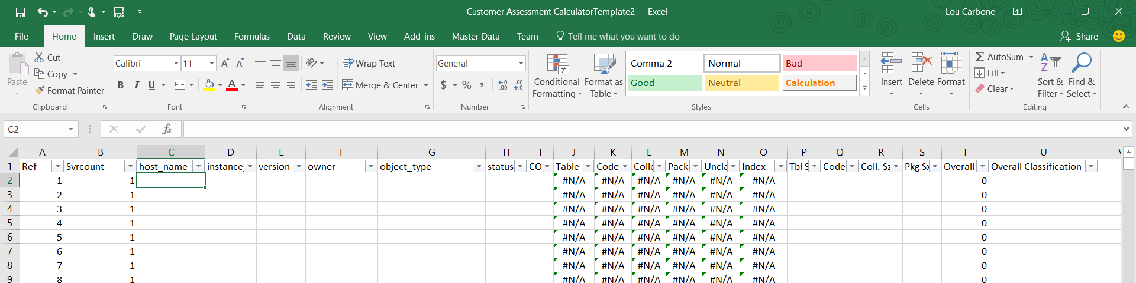
Using the output
The Customer Assessment Calculator
Data Migration Jumpstart Engineering Team

Slide 11
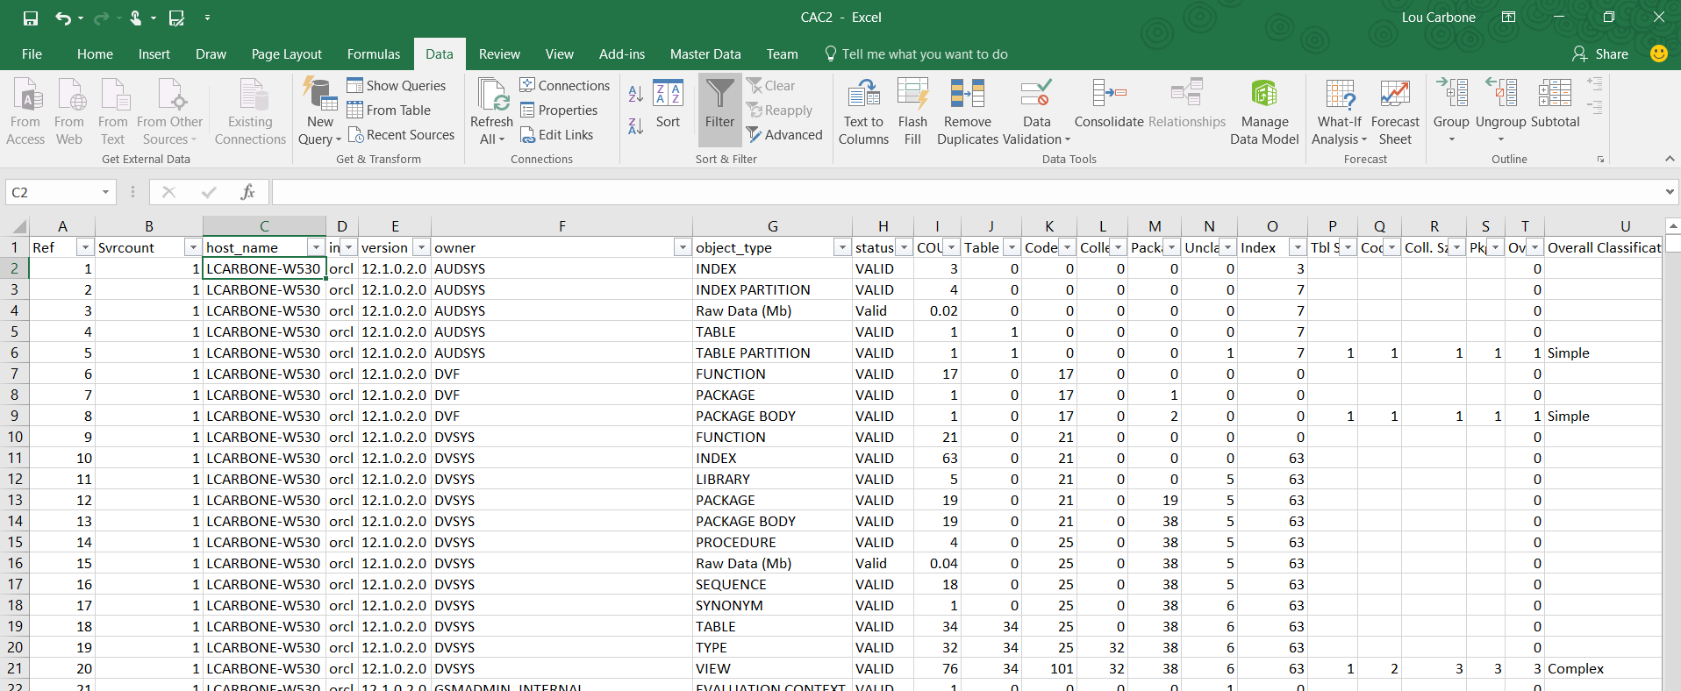
Populate the Calculator with the csv
Quick Estimate for Database Work
Data Migration Jumpstart Engineering Team

Slide 12
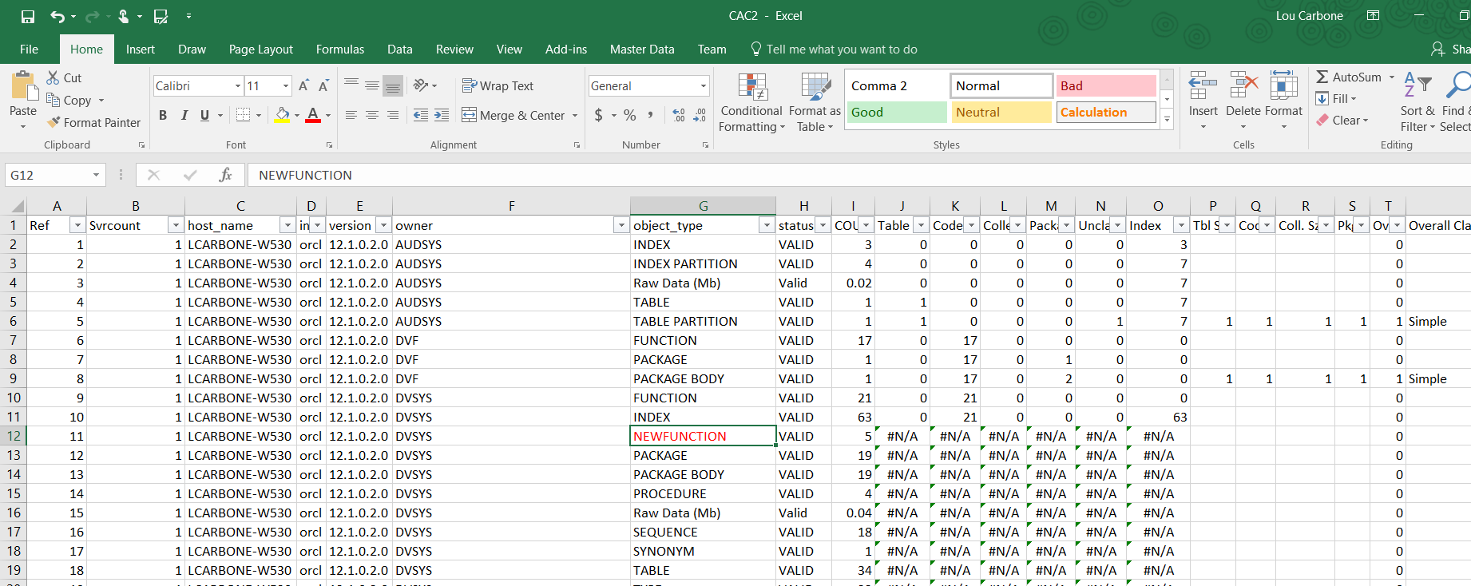
Sometimes it Breaks
Easy to fix
Data Migration Jumpstart Engineering Team

Slide 13
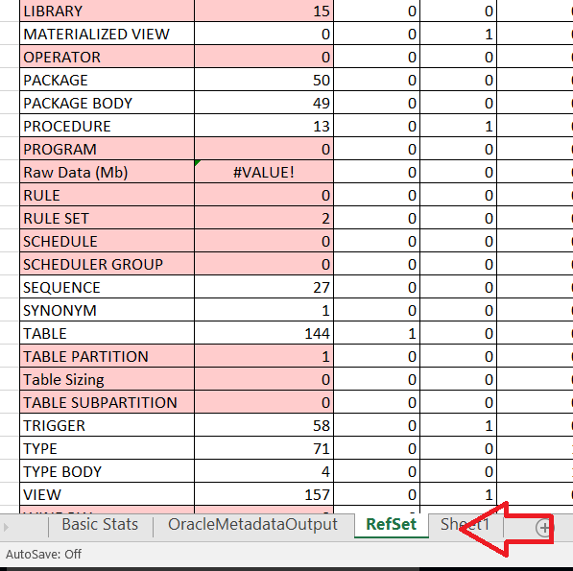
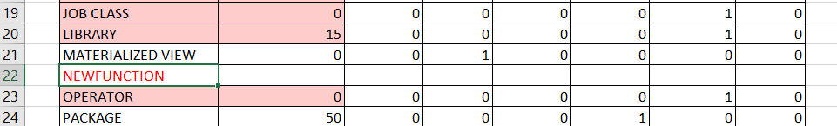
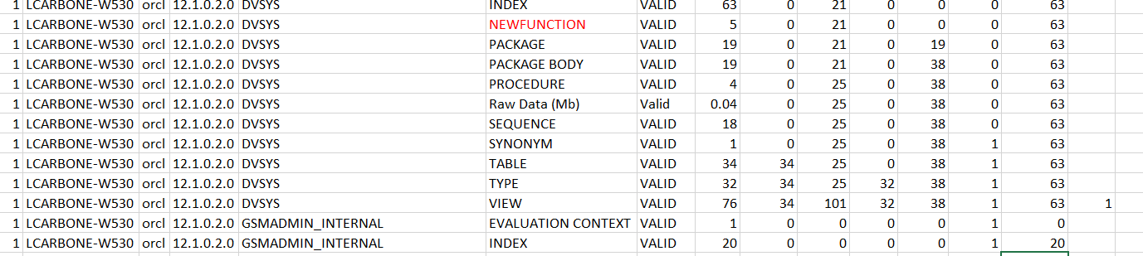
Sometimes it Breaks
Easy to fix
1. Go to the RefSet tab….
2. Insert new row in alphabetical order….
3. Presto!
Data Migration Jumpstart Engineering Team

Slide 14
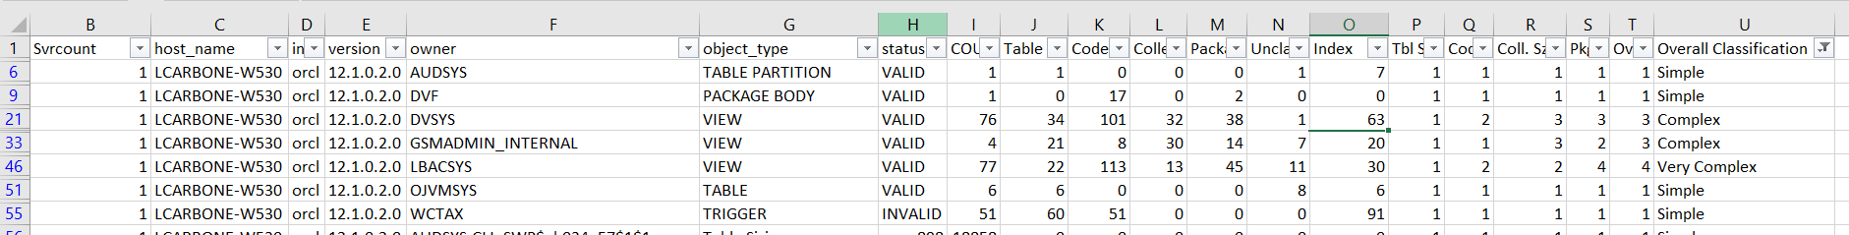
What it tells you
Target schemas, high profile package counts, et cetera
1. Go to the RefSet tab….
Data Migration Jumpstart Engineering Team

Slide 15
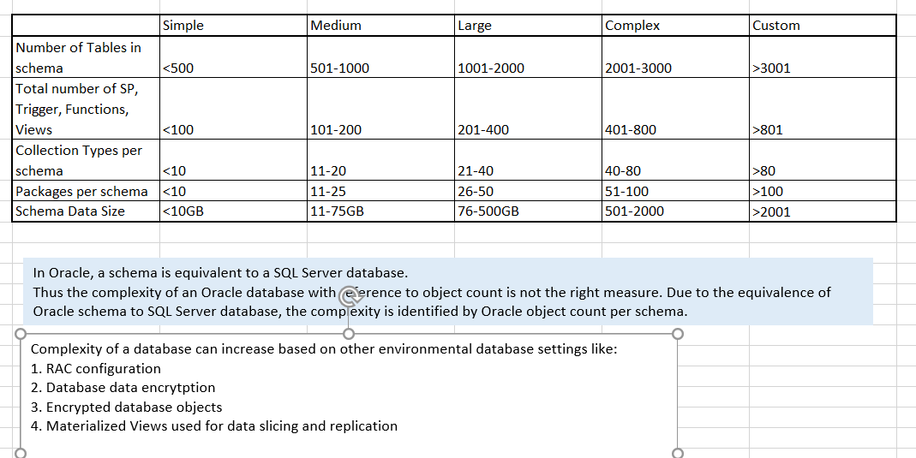
IGD Worksheet
Quick Estimate for Database Work
Data Migration Jumpstart Engineering Team

Slide 16
Support Community effort
Collecting Statistics
Send your CSV file to lcarbone@microsoft.com
Understand major object components
Develop a clear, consistent mitigation strategy
Help develop right IP
Data Migration Jumpstart Engineering Team

Slide 17
The tools
Data Migration Jumpstart Engineering Team

Slide 18

©2016 Microsoft Corporation. All rights reserved.
Data Migration Jumpstart Engineering Team

